Slide 1


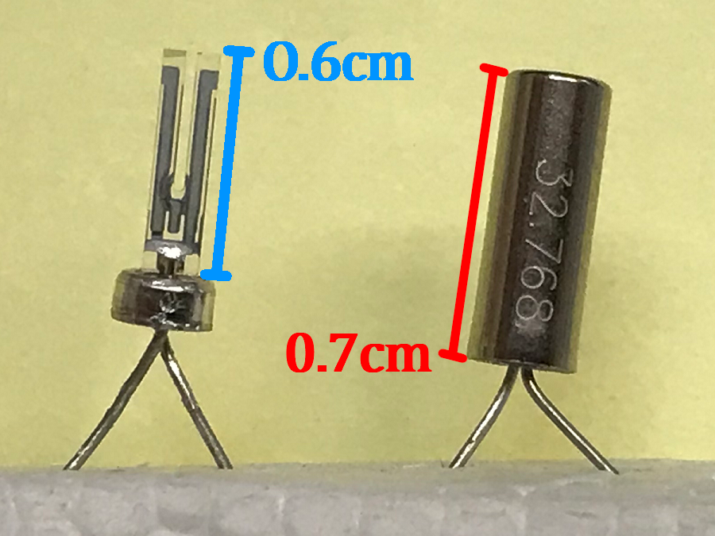
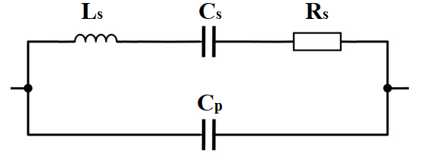
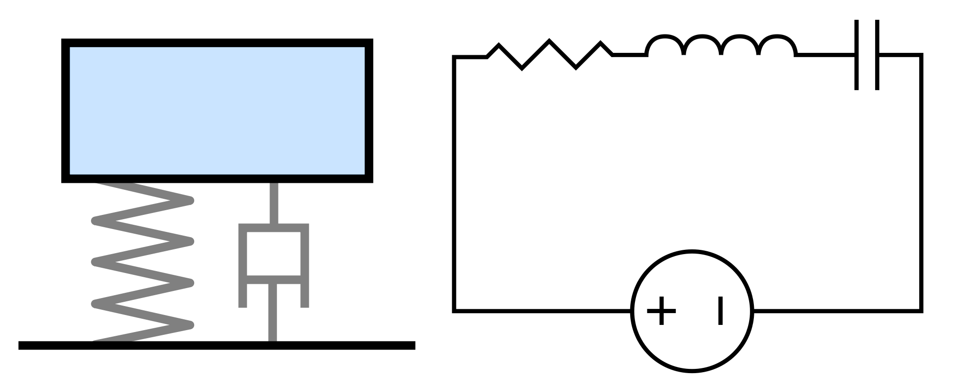
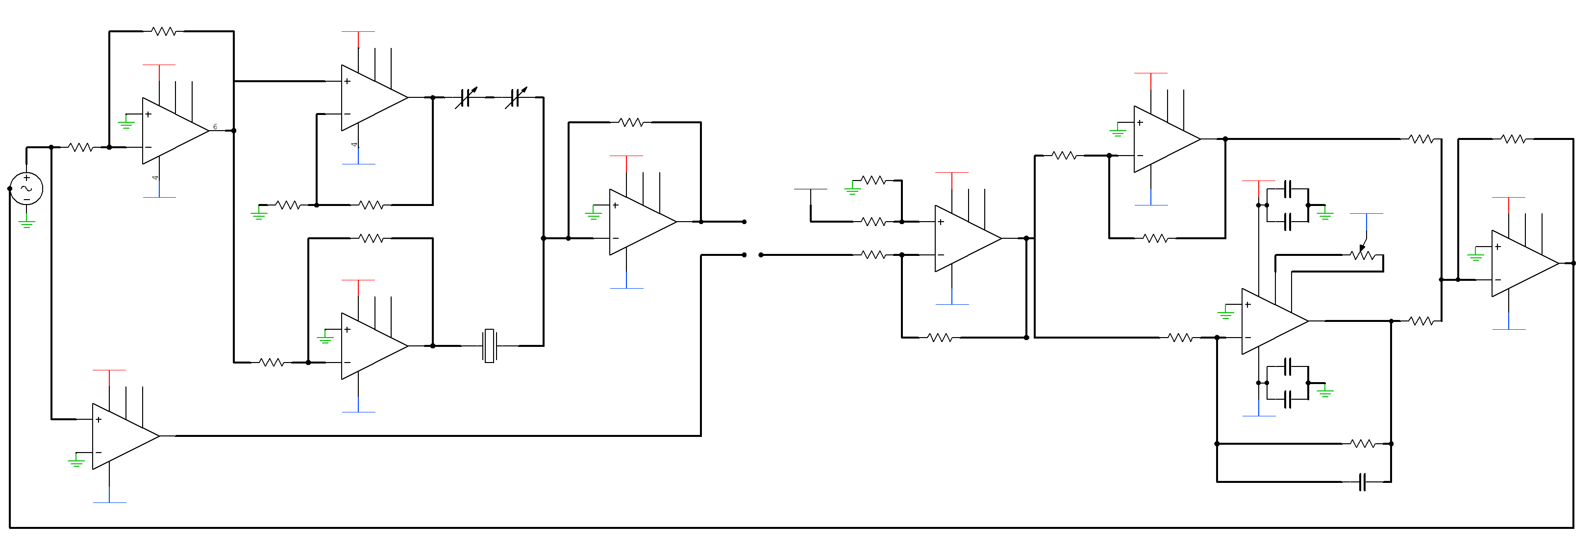
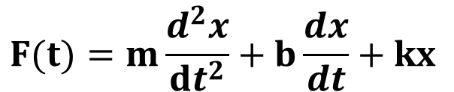
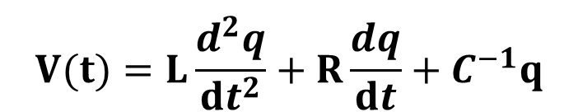
Quartz Tuning Fork Sensor
Mikhail Yakovlev
Department of Physics, Kwantlen Polytechnic University
Quartz Tuning Fork (QTF)
QTF is a resonator cut from quartz crystal. Main ). The main modern day application of QTF’s is digital watch and sensors.
Such resonator can be viewed as a mechanical oscillator system, as a damped mass on a spring. Due to piezo-electric properties of quartz, the resonator can also be viewed as an electronic oscillator composed of inductor, capacitor, and resistor placed in series.
A high quality resonator is characterised by a very sharp resonance. In case of QTF, it means that the output electrical signal is the largest at resonant frequency, and it drops of very rapidly if the fork is off resonance.
Compensating Unit
Electrode plates are used to set QTF in motion using applied voltage. The electrodes introduce also parasitic capacitance, represented as a capacitor placed in parallel to the main components.
Parasitic capacitance complicates the use of QTF for sensory purposes in two ways:
It introduce an electronic disturbance to the mechanical oscillator system;
Parasitic capacitance alters the frequency response from sharp peak into a peak-dip shape
Compensating capacitor is necessary cancels out the parasitic capacitance signal. This is achieved by powering QTF through inverting amplifier, while compensating capacitor is powered through non-inverting amplifier.
PI Controller
The controller conditions the phase difference voltage before using it in frequency modulation. When QTF senses disturbance, proportional (P) gain unit drives the fork to find new resonance. Once reached, integral (I) unit action takes place be zeroing steady-state error. When settled, the system has found equilibrium and measurement may be taken. Such is the principle behind phase locked.
↑F
m
R
L
↑x
C
k
b
↑q
V
$$F(t)=m\frac{d^{2}x}{dt^{2}}+b\frac{dx}{dt}+kx$$
$$V(t)=L\frac{d^{2}q}{dt^{2}}+R\frac{dq}{dt}+C^{−1}q$$
Lock-In Amplifier (LIA)
In order to use QTF as a sensor, there needs to be a way to utilize fundamental principles of QTF. Besides the amplitude of QTF output, the signal also has phase difference with the powering voltage. LIA allows to perform the comparison of sinusoidal QTF output to the saturated, square-wave input. Additionally, it also provides voltage output proportional to the size of phase difference.
Conclusion
To verify the phase-locked loop, QTF was placed in the path of air current. When increasing the flow, the output of PI controller changed, while phase stayed at near zero. The fact that the loop shifted operating frequency without affecting phase difference confirms that the principle behind the sensor circuit.
New resonance is found
R2
+
Compensating Unit
+
PI Controller
+
1
3
R3
R6
R1
C2
+
+
7
-
Reference
+
+
-
5
-
-
+
6
R4
9
QTF
-
LIA
-
4
8
-
+
2
-
-
R5
-
C1

